Slide 1
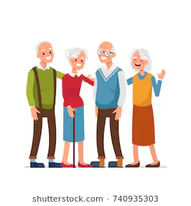
Ol’ Friends
-Share your stories, connect your lives

Slide 2
Why are we here
To deal with the loneliness issue of the elderly
Encourage the elderly to be proactive socially
Notes:
Present solutions to the problems that the elderly in Singapore face.
To deal with the loneliness issue of the elderly.
Encourage the elderly to be proactive socially.

Slide 3
Elevator Pitch
For the elderly in Singapore
Who are lonely and are not exposed to social media before
The Ol’ Friends is a simple social app
That provides a fuss-free and elderly friendly social platform that helps cope with their loneliness, therefore, mitigating further serious issues like depression.
Unlike Facebook which is targeted at an wider audience with a more complicated user interface
Our project is fuss-free and simple to use which is of more convenience to the elderly.

Slide 4
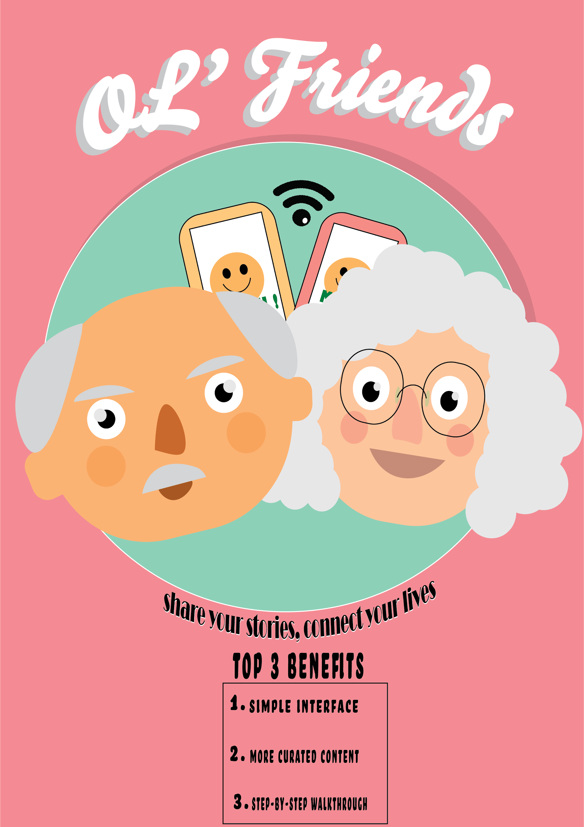
Product box
Notes:
##I think we are suppose to put only like the product box/poster there without the things at the side

Slide 5
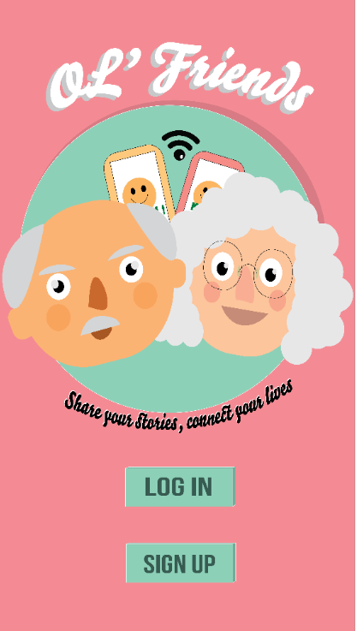
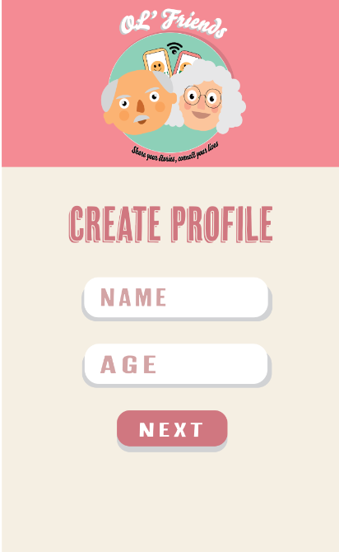
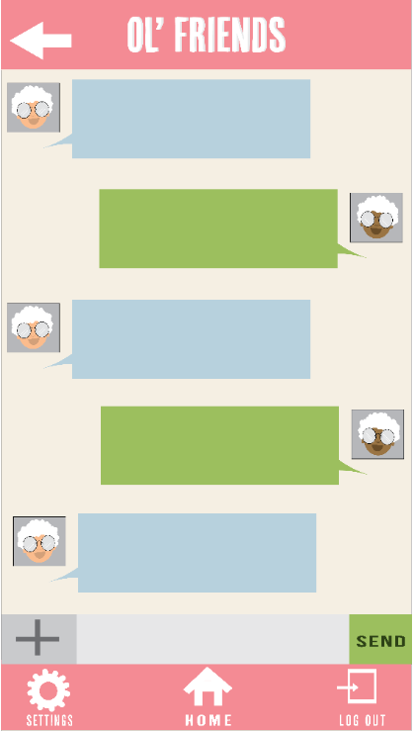
Some Screenshots Of the App

Slide 6
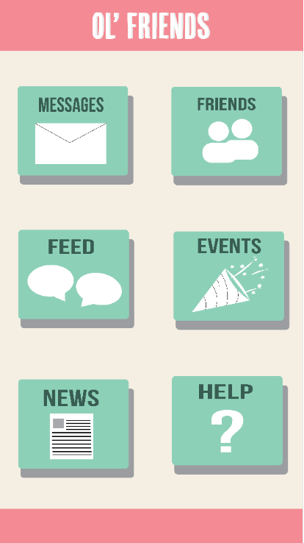
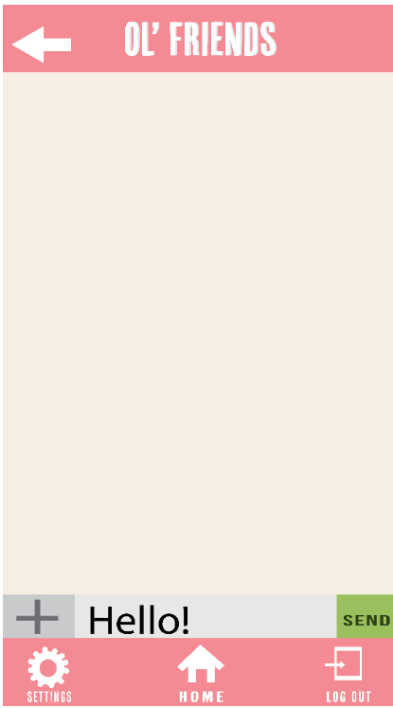
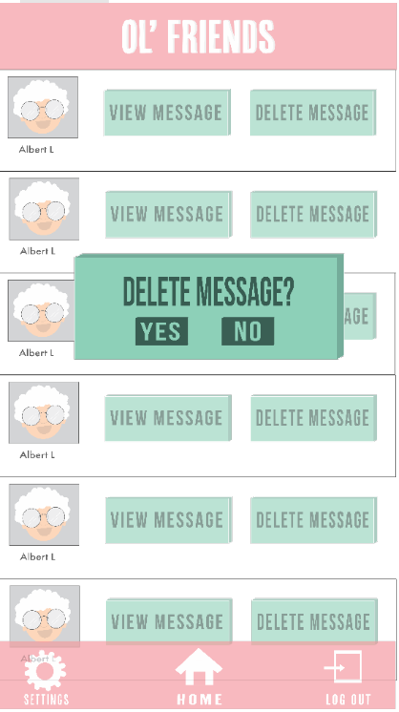

Slide 7
The NOT list
IN Scope
Login
Messaging - allows user to message their friends
Content Posting - allows user to post things
Commenting features - allows user to comment on friend’s post
Simple interface (Bigger Fonts), Easier Navigation (Navigation Bar) and Autofill Email
News - allows user to view latest news
Help feature - user is able to view help on how to use the app
Language Change (Flexibility)
OUT Scope
Voice Help
Friend Suggestion
Ban system + Status feature
Reminder (Notifications)
Broadcasting of Events (Based on similar interests)
Notes:
IN Scope
Simple interface (Bigger Fonts), Easier Navigation (Navigation Bar) and Autofill Password
Messaging + Content Posting and Commenting features
Onboardingscreen app tutorial
News
Broadcasting of Events (Based on similar interests)
Out Scope
Voice Help
Friend Suggestion
Ban system + Status feature
Reminder (Notifications)
Language Change (Flexibility)

Slide 8
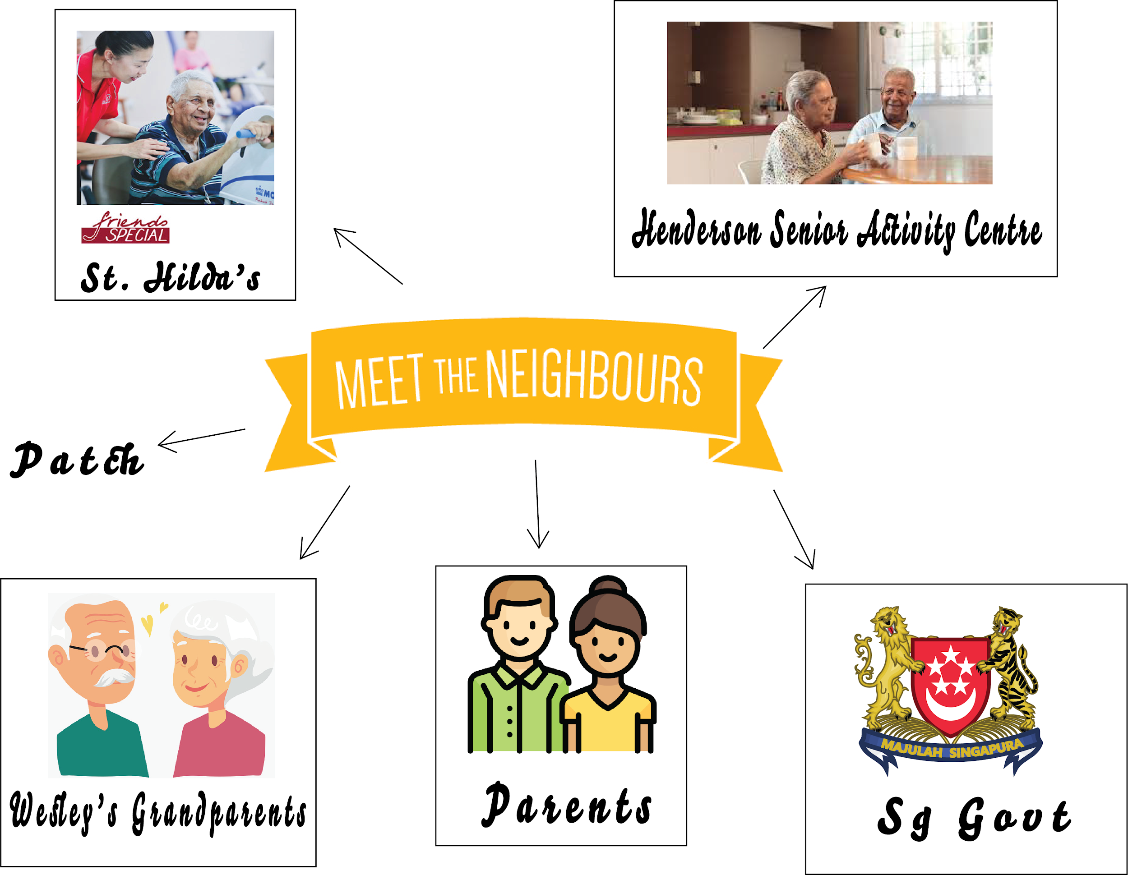

Slide 9
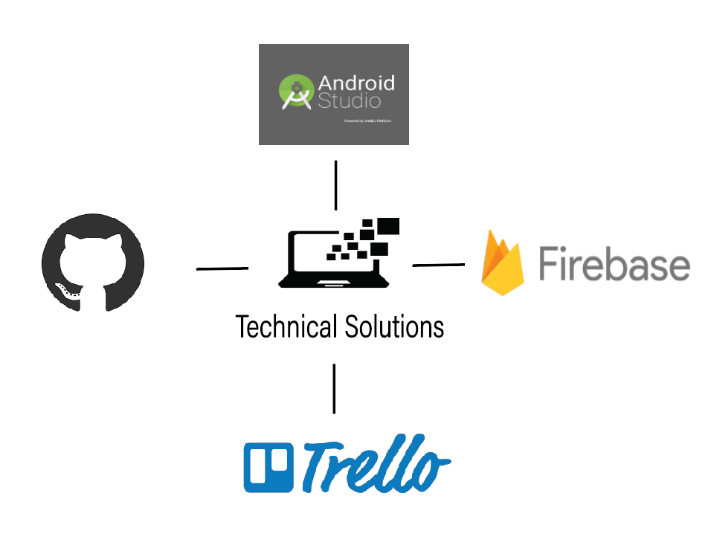
Technical Solutions
Android Studio
Java Programming Language
Easy to program Android apps
Github
Compatible with Android Studio
Firebase
Easy to use realtime database
Trello
Easy to organize scrum and sprint details with Trello (Kanban Board)

Slide 10
Timeline
Planning Phrase (wk 1- 2)
Features, Problems, Solutions, Feasibility
Heckathon
Code as much of project as possible
Demo DAy
Present finalized project
10/29/18
1/7/19
10/16/18
11/13/18
1/21/18
Sprint Backlog(wk 3 - 4)
Wireframing, UX design
Final Phase
Clean up, make necessary/ additional adjustments to project

Slide 11

Trade-Offs
Rating | Trade-off
 | Money
 | Time
 | Scope
 | People
 | Quality
1 represents No trade-off, 5 represents OK to trade-off.

Slide 12
The A-team
Wesley Qua
Roles: Programmer
Expectations: Back-End Coding, Database Manager
Competencies: C#, C++, Python, Android Studio (Java), Firebase (Database)
Marcus
Roles: Programmer, Planner
Expectations: Front-End and Back-End Coding
Competencies: C#, Android Studio (Java Novice), Database (MySQL)
Kheng Hin
Roles: Programmer, Planner
Expectations: Front-End and Back-End Coding
Competencies: C#, Python, Firebase (Authentication), Android Studio (Java), Database (MySQL, SQLite)

Slide 13
The A-team
4. Yu Chyi
Roles: UI/UX Designer, Researcher, Planner
Expectations: Find statistics/data to elevate our project, Front-End, app design management,
Planning management (Keep the team on track according to timeline set)
Competencies: HTML, CSS, Wireframe
5. Rai
Roles: UI/UX Designer, Researcher, Planner
Expectations: Management of app design and interface, Planning management (Keep the team on track according to timeline set), Find statistics/data to elevate our project, Soft skills tasks in the project
Competencies: HTML, CSS, Wireframe, Adobe Illustration

Slide 14
Thank you

Slide 15
Comparison with other similar apps
 | Friend search | Posting content | Events | Message | News | Setting | Help
Facebook | ✅ | ✅ | ✅ | ✅ | ❌ | ✅ | ❌
Stitch (web) | ❌ | ✅ | ❌ | ✅ | ❌ | ✅ | ❌
Instagram | ✅ | ✅ | ✅ | ✅ | ❌ | ✅ | ❌
Ol’Friends | ✅ | ✅ | ✅ | ✅ | ✅ | ✅ | ✅

Slide 16
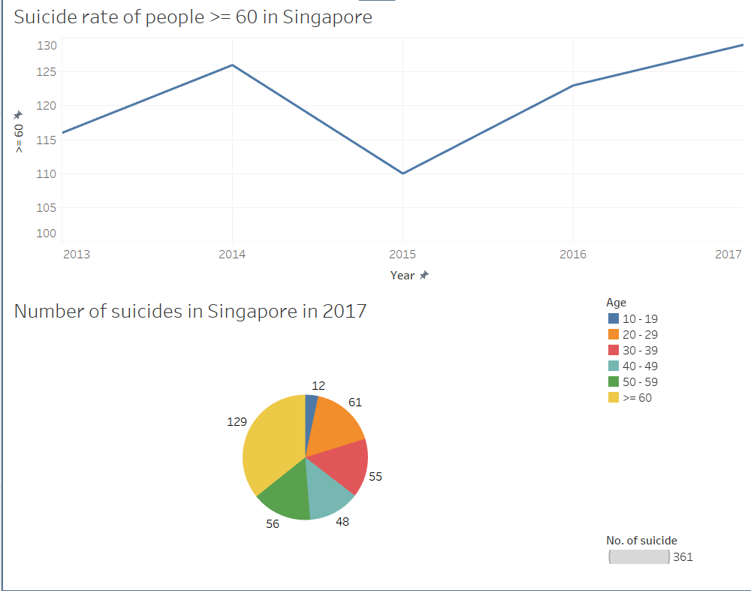

Slide 17
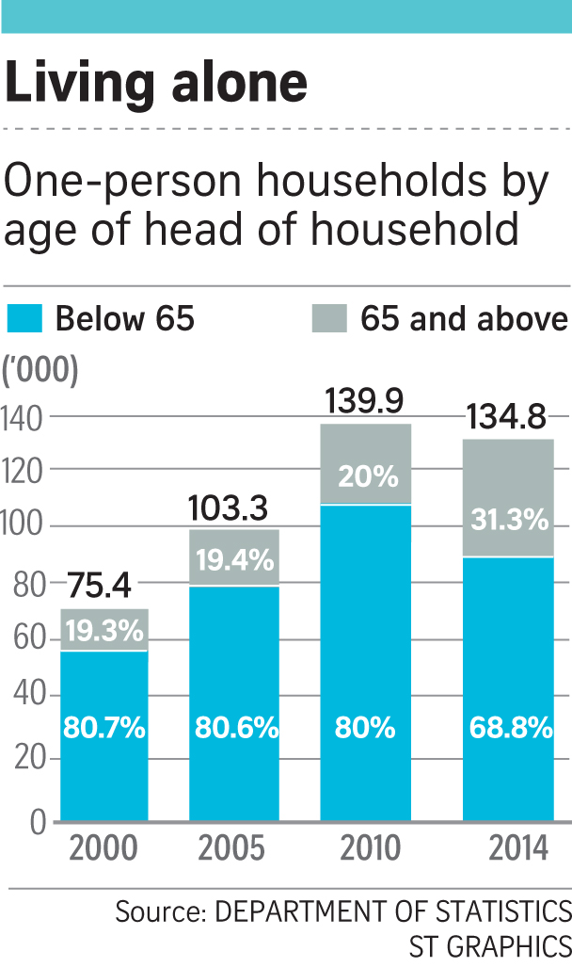

Slide 18
Questions which keep us up at night
Is there any market for this app? Is there even a need for it?
Will this app really work when social media apps like Facebook (which has an older demographic) exists? How will it compete with Facebook?
Is there a demand for this app⇒ Are the elderly that tech advanced that they would have a need/want for an app like this?
How will this app benefit the elderly community?
You talk about a simpler interface, but can’t that be addressed with the changes in Facebook’s settings.
How can we sell our app?
Do similar apps that target the elderly already exist? If yes, how do we differ from them?
Are we able to deliver a prototype in the given amount of time?
What is unique about our app that will make the elderly use it?

